Slide 1
Introduction to Flask
Presented by: Manal Asghar

Slide 2
What is Flask?
Flask is a lightweight and flexible web framework for Python.
It is designed to make web application development simple and efficient.
Developed by Armin Ronacher and first released in 2010.

Slide 3
Why Use Flask?
Ideal for small to medium-sized web applications
Provides greater control over application components
Supports RESTful API development
Easy integration with databases and third-party libraries

Slide 4
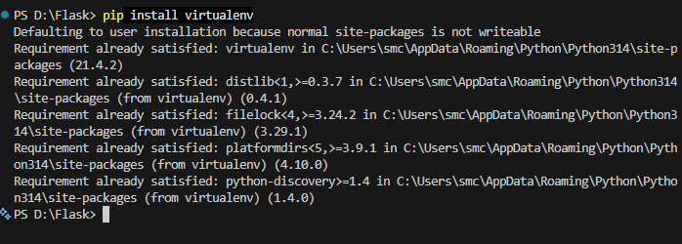
Steps:1
First make a folder of Flask, then use these command type this command to make virtual environment

Slide 5
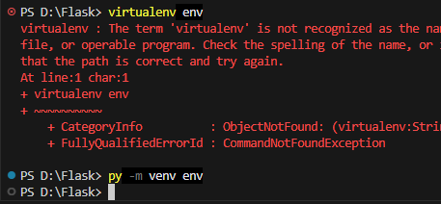
Step:2

Slide 6
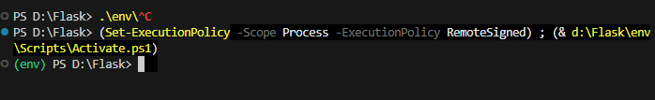
Step:3(Activate environment)
Type env press tab it will execute

Slide 7
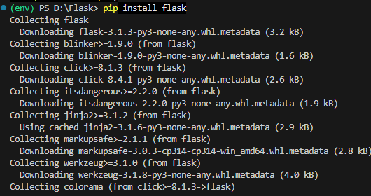
Install flask

Slide 8
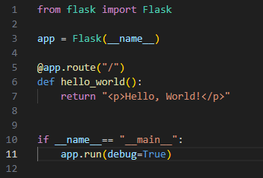
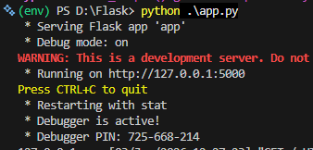
Make a File
Make a new file with name app.py
App.py name is used in flask documentation

Slide 9
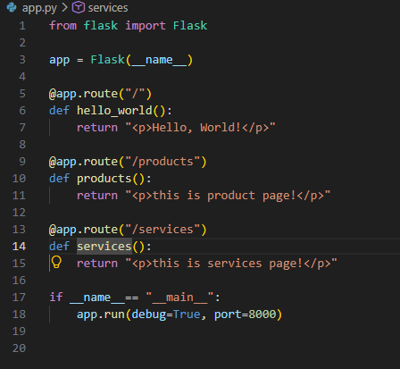
Make Multiple route
Do not use this for production

Slide 10
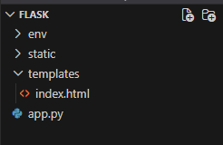
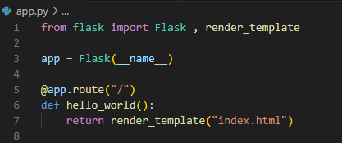
Directories
Add two directories for static and templates.
Now we can render index.html file in app.py
from flask import Flask , render_template

Slide 11

Database
From flask _sqlalchemy import sqlalchemy
SQLAlchemy is a Python library used to interact with databases. It acts as an ORM (Object Relational Mapper), allowing you to work with database tables using Python classes and objects instead of writing raw SQL queries.
SQLAlchemy is a Python library used to interact with databases. It acts as an ORM (Object Relational Mapper), allowing you to work with database tables using Python classes and objects instead of writing raw SQL queries.

Slide 12
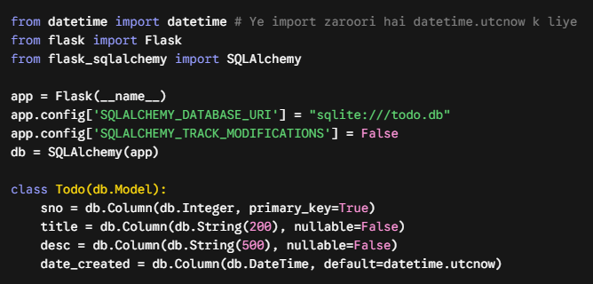
Database

